Slide 1
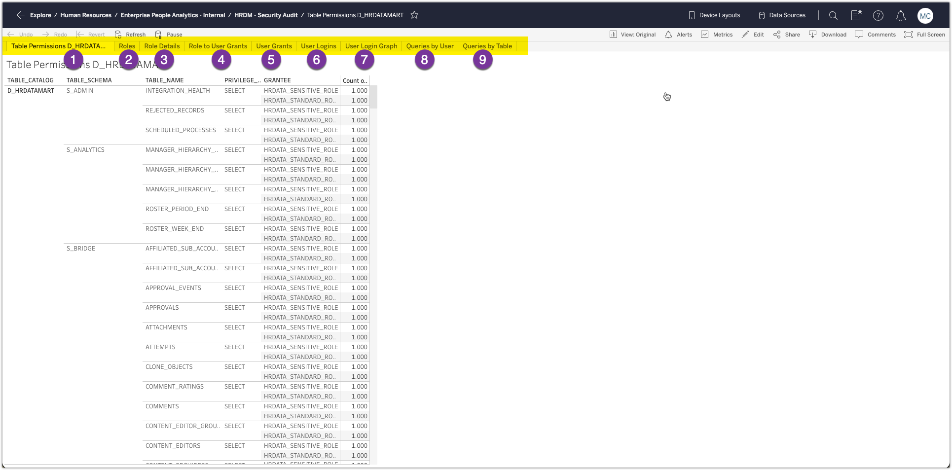
Available Tabs
Tables view and which Roles have select access
Role Summary view - # of users, other roles, etc.
Role Details – Specific Permissions
Role to User Grants (by Role / User)
User Grants (by User / Role)
Logins and Details
Graph of Logins by Day / Hour
Queries by User
Queries by Table

Slide 2
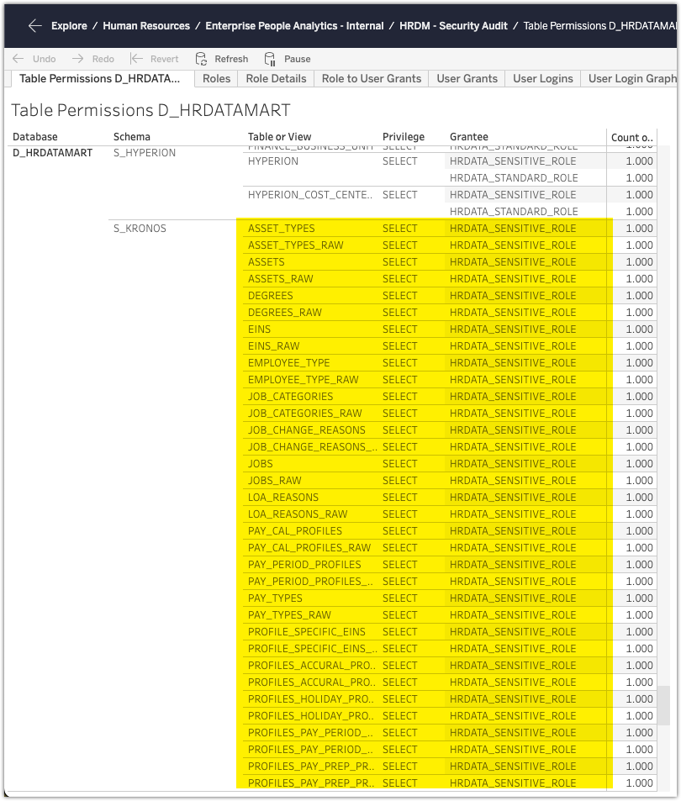
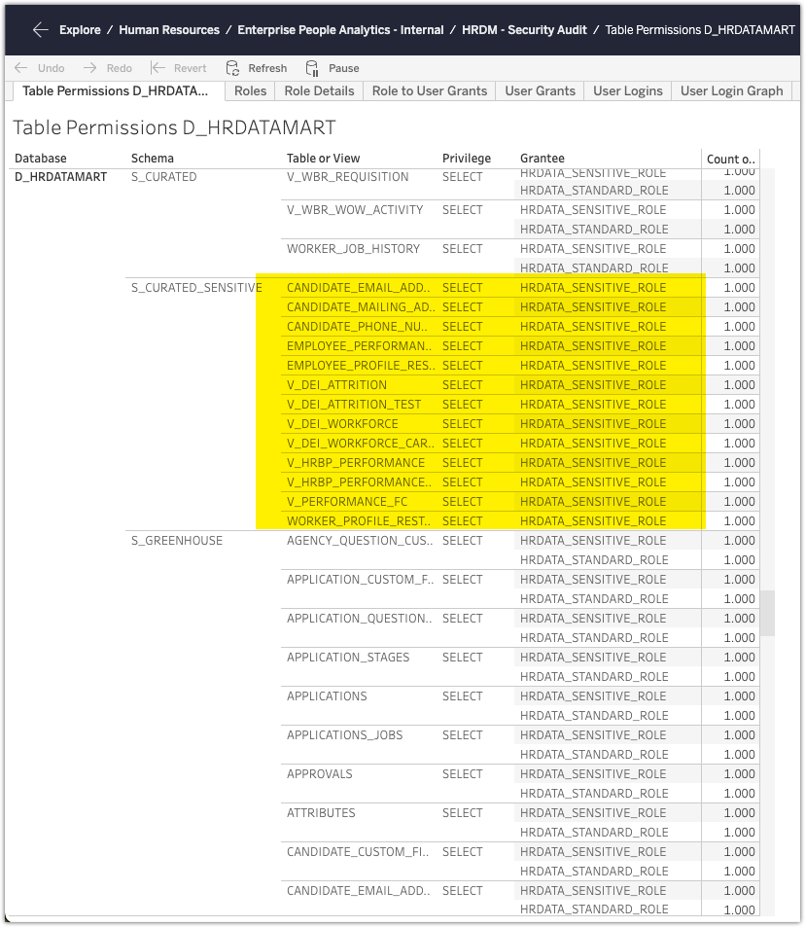
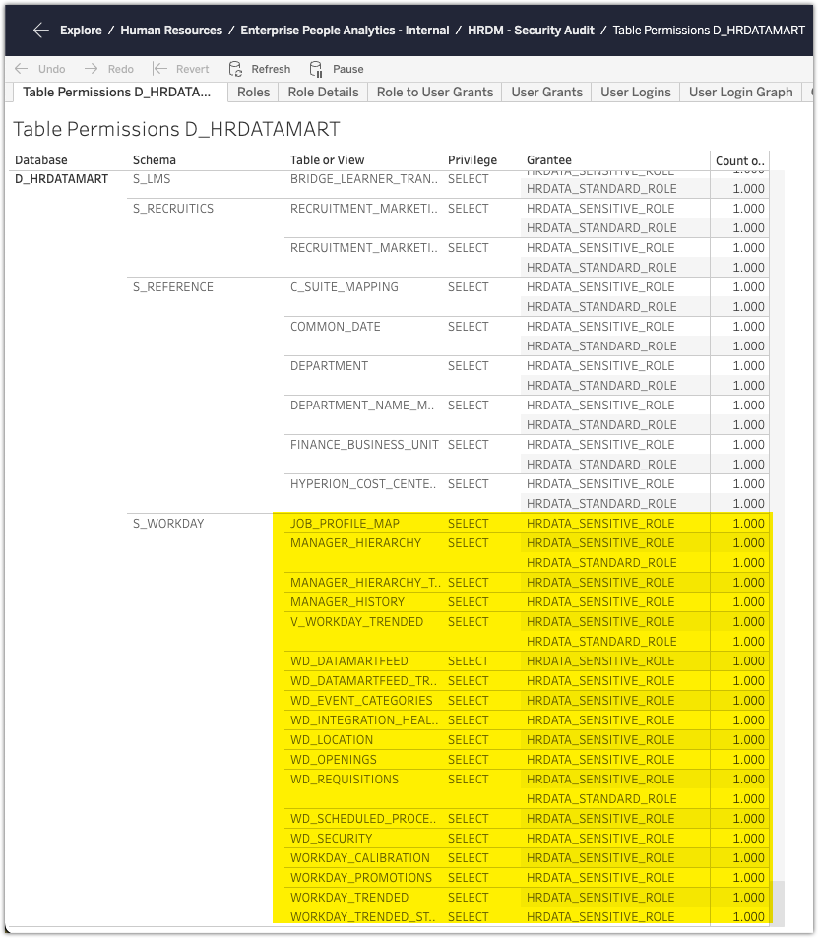
Tables (in D_HRDATAMART)
We should check the other two inconsistencies to double check…
Not sure why S_KRONOS is only granted to SENSITIVE – it’s all reference data Workday data is a mix of Sensitive and standard. Some of them definitely don’t need to be sensitive only (reference data – job profile? Location?)
S_CURATED_SENSITIVE is correctly granted to only SENSITIVE ROLE.

Slide 3
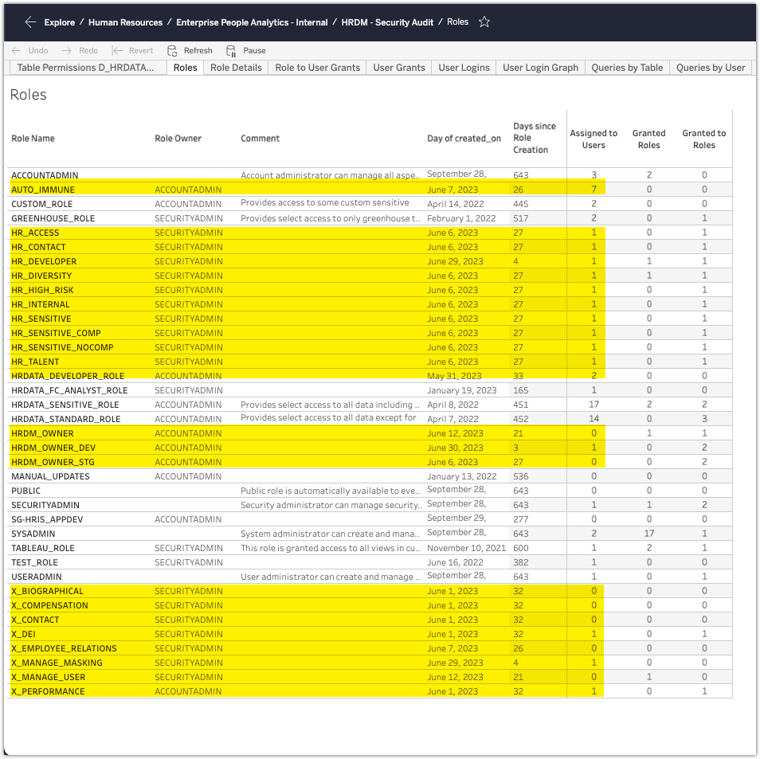
Roles
There’s a whole bunch of new Roles in the Data Mart (all have very few or no users, so not worried about them, but left them outside the scope of this assessment as I think the team is in the midst of transitioning)
Things to look at
1. Review Custom Role, Greenhouse Role and HR Data FC Analyst Role
2. Check to see if we still need some of these Roles and cleanup (Manual Updates, SG-HRIS_AppDev, Test_Role) – also do we need both SysAdmin and UserAdmin?
3. Check to align Sensitive and Standard roles – there should NOT be more people that have access to Sensitive than there are to Standard

Slide 4
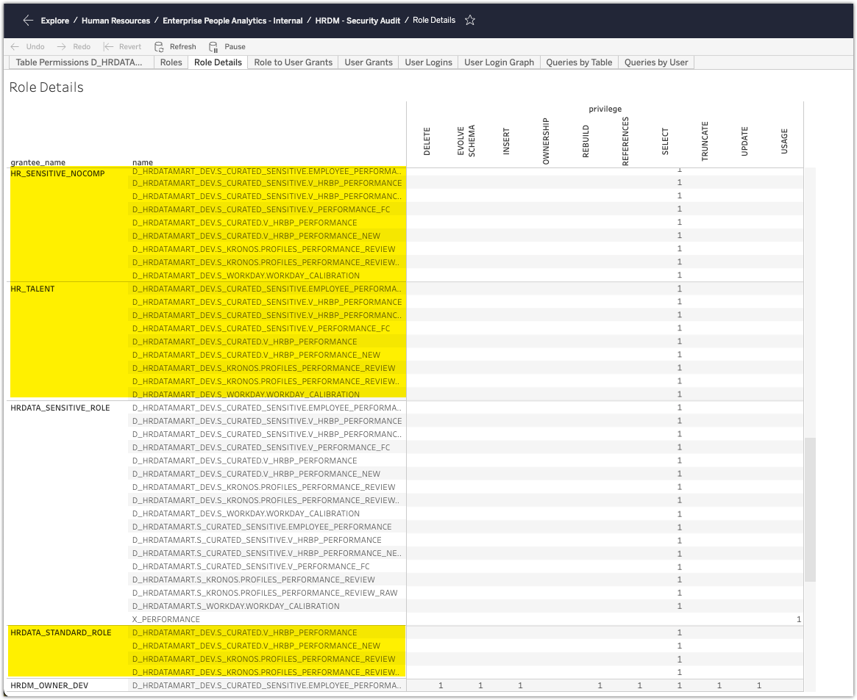
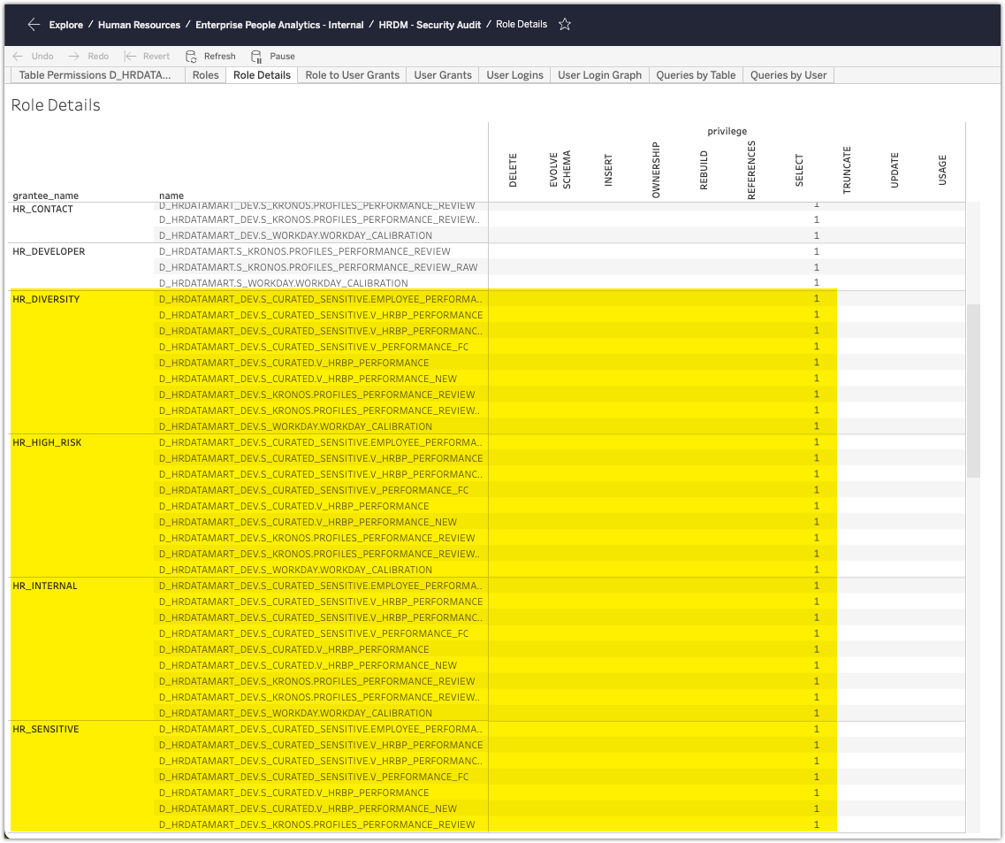
Role Details
Looking at just the performance data, we see a couple things that are interesting.
All the new roles seem to be granted all the tables within Workday_Dev. don’t think this is appropriate.
For some reason the Standard Role has the performance data in dev…not sure we’ve ever seen or noticed that before, but that’s not right…we should check what it has access to

Slide 5
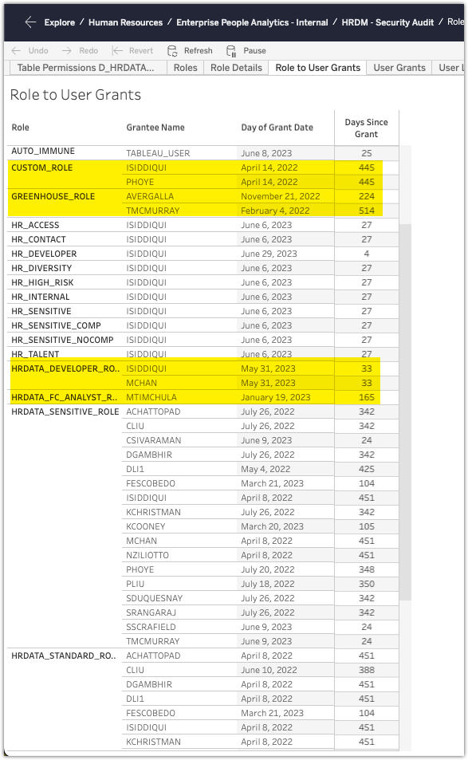
Role Grants to Users
Custom Role was created for Pat. We should check, but he shouldn’t need it since he has access to the Sensitive Role
Greenhouse Role may be redundant as well. Tyler has access to the other roles and Alexis might not need it (see slides coming up on logins, and user grants)
Should remove Matti from Developer Role – doesn’t need access to NavEx data anymore as data has been profiled and modeled already
Check and create new plan for FC Analyst role – originally used to read data from the FC Sandbox, but since David G is no longer here, there’s no one writing data to the FC Sandbox – need to check and re-evaluate strategy for FC with Mark T.

Slide 6
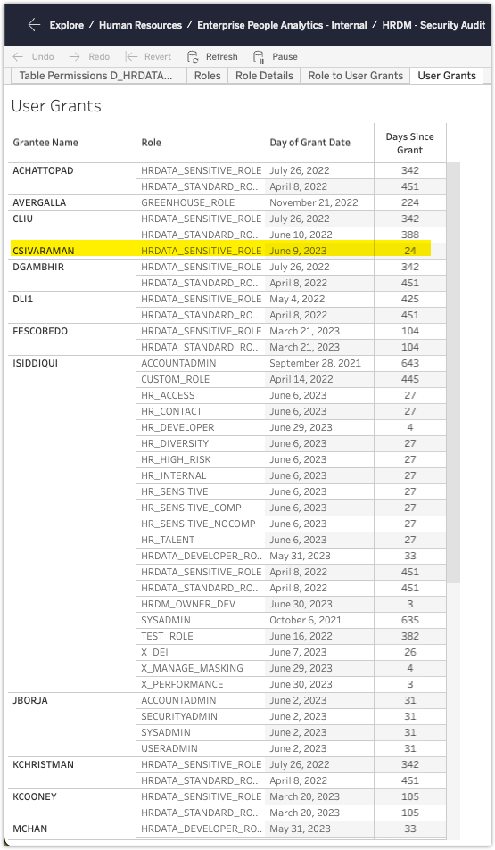
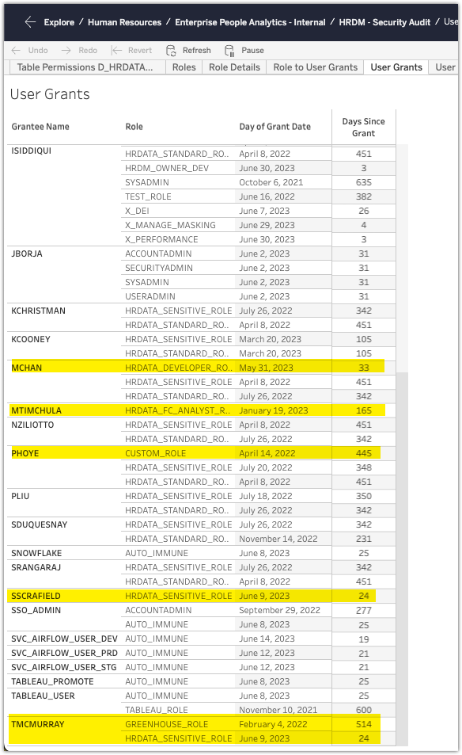
Roles by User
Looks like the last couple updates to permissions aren’t following our best practices / guidelines. Chan, Tyler, Stefan were all given the Sensitive role, but not the Standard role. Users shouldn’t be just defaulting to the Sensitive role for everything if they aren’t querying sensitive data (i.e. Headcount reporting). They should be granted the Standard Role – should also probably get rid of the Greenhouse Role as it’s redundant
Should remove Custom Role for Pat
Should remove Developer Role for Matti

Slide 7
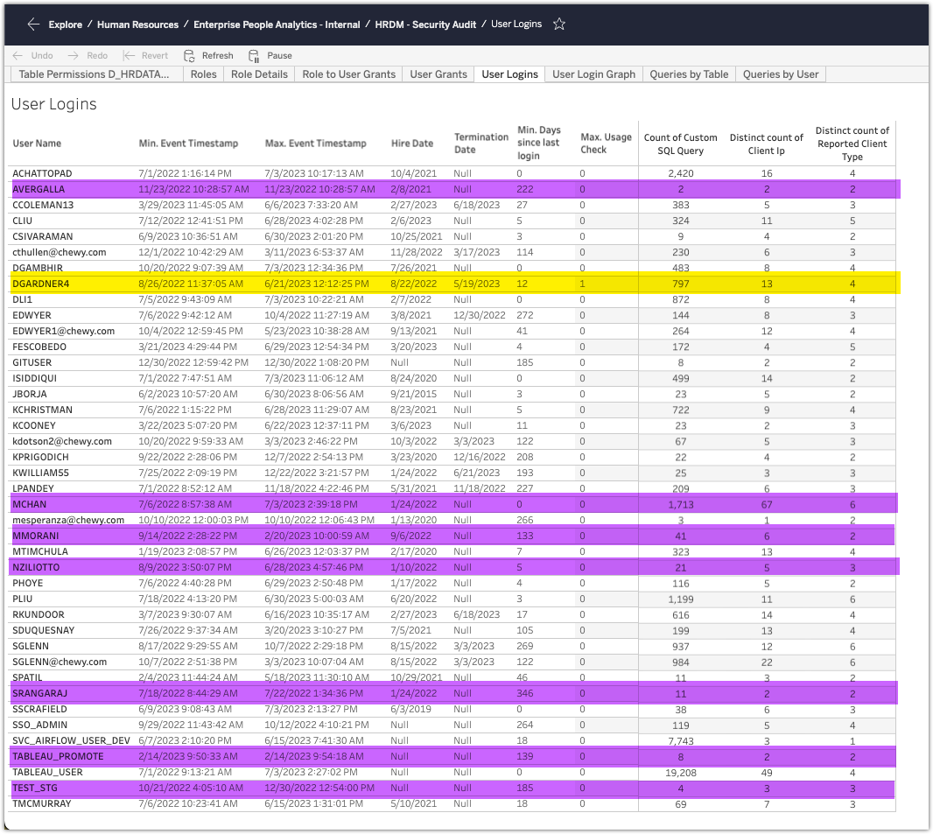
User Logins
Need to check why David G has logins almost a month after his termination. My guess is it has something to do with Knime workflows, but we should check to double check and make sure. See next slide for *some* details, but thorough assessment needs to happen between Data Mart and EPA teams to figure out where that was running / using that ID.
Review the Purple Highlighted ones
Matti and Michelle don’t need access anymore
Sadie and Alexis might not need the access – haven’t logged in in 300 / 200+ days respectively
Does Nicole still need access in her new role?
Do we still need tableau_promote and test_stg users?

Slide 8
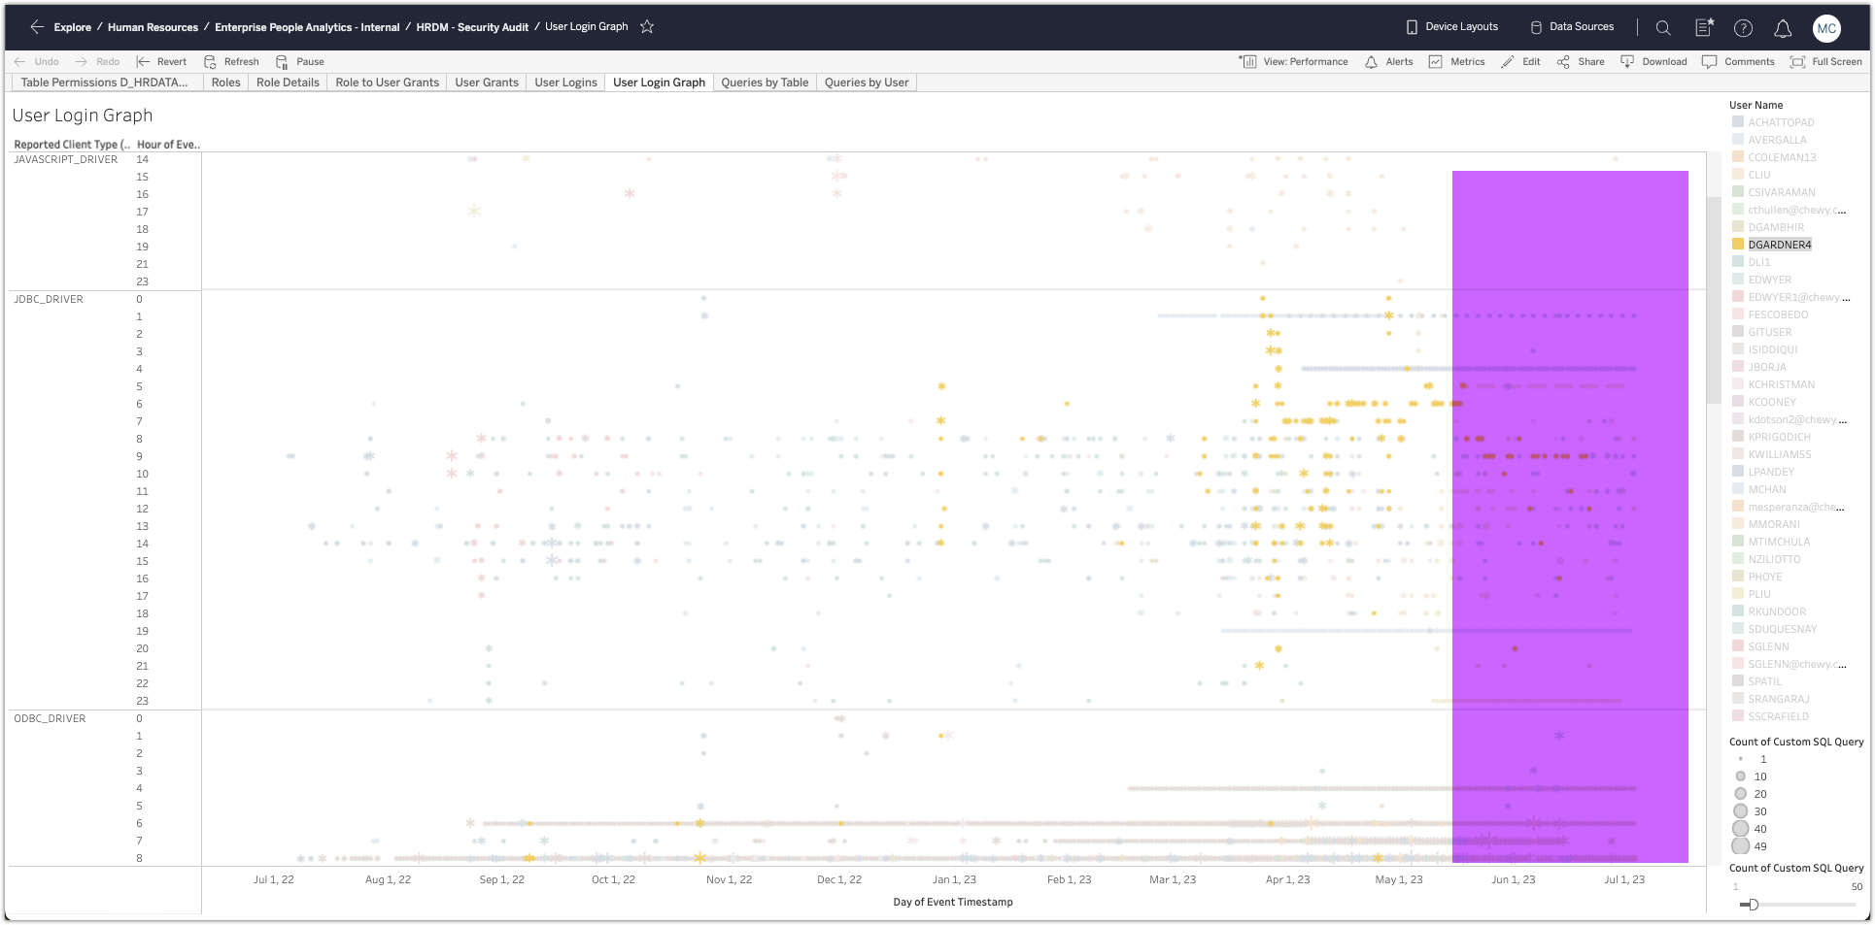
Login Details
Filtered for David G. For some reason things still running after he left. Looks like a KNIME workflow or something that has his embedded credentials, but doesn’t look like it’s the same time, so someone must be running them manually throughout the day – not great.

Slide 9
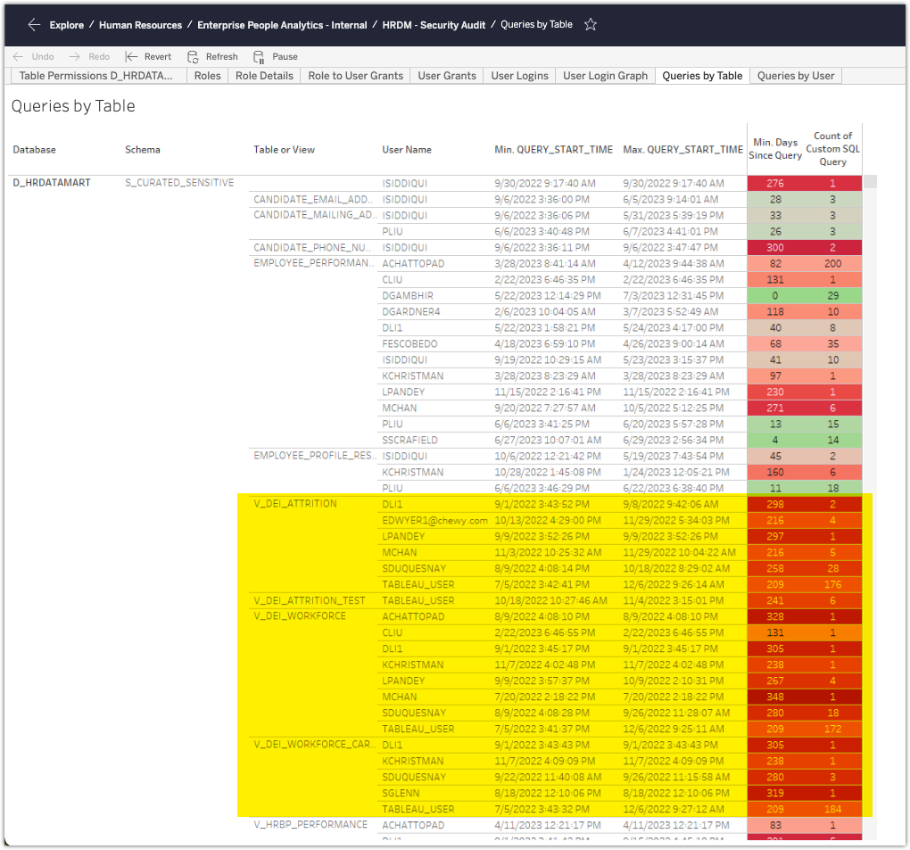
Queries by User and Table
We might be able to sunset some of the old views…they don’t look like they’re being used anymore (finally). This tableau view also gives a look at who is querying each object and you can take a look at each individual table in question
I would start with the sensitive data – custom fields, performance, DEI, navex data, etc.
Can also drill down, and look at individual data to see what queries are being run

Slide 10
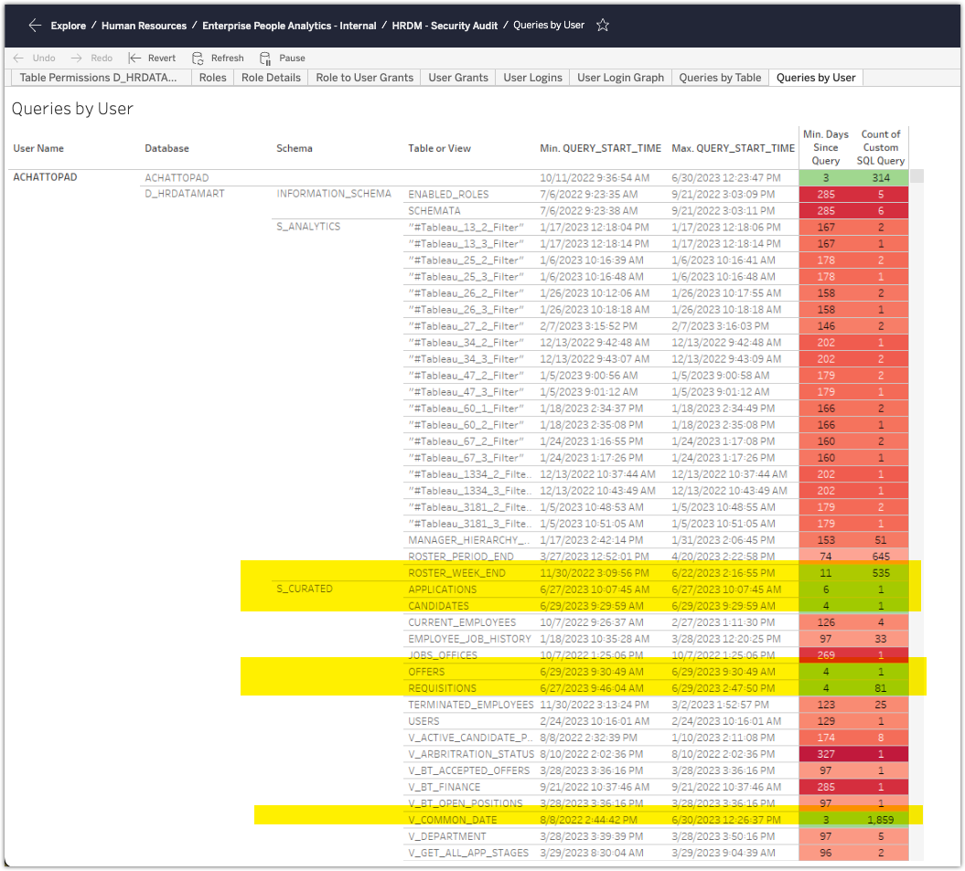
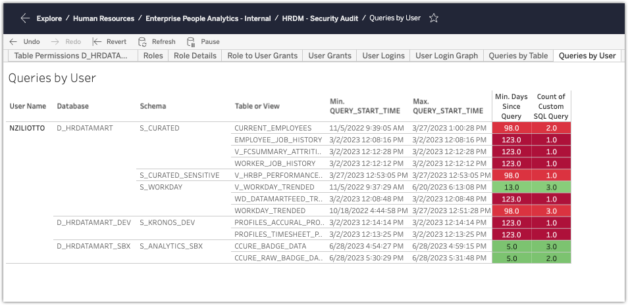
Queries by User and Table (starting with User)
Pivoting by user, you can see that Arun is using the right tables and has transitioned off the old views.
Can also filter by user, for example, here’s what Nicole has been querying against (in case you want to see if she still needs access in her new role)

